Slide 1
That #@$%&! teaching philosophy!
Putting Together the Teaching and Learning Activities Section

Slide 2
Yes, you actually do have a teaching philosophy!
Goals and Objectives
Cognitive
Affective
Behavioral
Skills
Ethics
These tenets implicitly and explicitly guide you every day as you plan and deliver instruction.

Slide 3
How do you go about making the implicit explicit for the purpose of writing this section of the portfolio?

Slide 4
1. Figure out what your teaching philosophy really is.
Read the section and Nuts and Bolts box in the Handbook, pages 14-15.
Try out some self-assessments: https://tgi.its.uiowa.edu/ and Google “Teaching Style Survey” and “Teaching Goals Inventory.”
Read some other advice:
http://www.celt.iastate.edu/faculty/document-your-teaching/writing-a-teaching-philosophy-statement
https://academics.lmu.edu/cte/about/archives/2013committeeonthecomprehensiveevaluationofteaching/teachingnarrative/
Look at samples: https://www.uky.edu/~drlane/teaching_philosophy.pdf and Google “teaching philosophy samples”

Slide 5
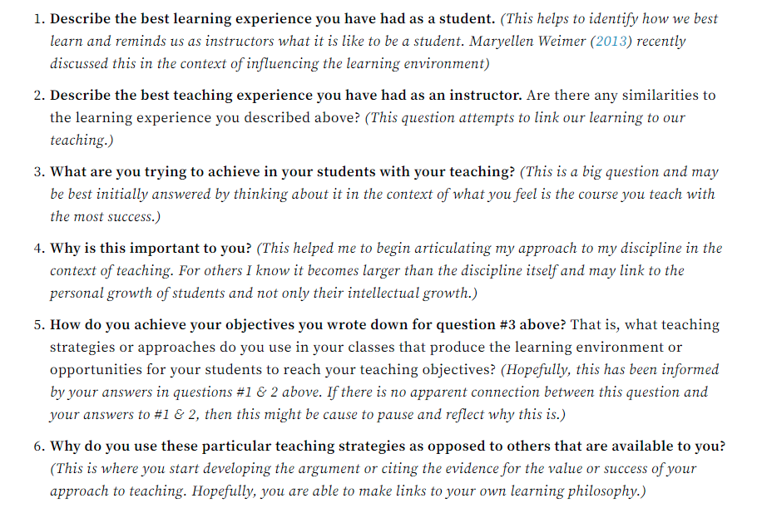
https://www.facultyfocus.com/articles/philosophy-of-teaching/six-questions-will-bring-teaching-philosophy-focus/

Slide 6
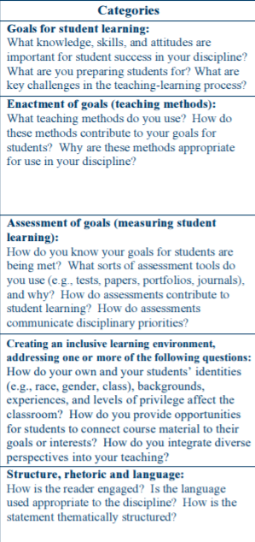
https://crlt.umich.edu/sites/default/files/resource_files/CRLT_no23_revised.pdf

Slide 7
2. Write down the essential tenets of your philosophy.
How many? Pick maybe four to ten—it’s your call.
Organize them in some way. Do what makes sense.
academic ones and affective ones?
content vs. skills vs. attitudes?
importance order?
Decide how you’re going to present them.
philosophy first—just discussing the “theory”—and then a separate section of narrative—with a discussion of the “practice” in each course?
merge the two sections by discussing each tenet in theory and then giving examples of how you put it in practice in your class?

Slide 8
General Intro
Value I
Name it
Explain it (what it is, its value)
Value II
Name it
Explain it (what it is, its value)
Value III
Name it
Explain it (what it is, its value)
Value IV
Name it
Explain it (what it is, its value)
Paragraph transitioning into discussion of specific courses
Course 1
How Value 1 is demonstrated/assessed
How Value II is demonstrated/assessed
How Value III is demonstrated/assessed
How Value IV is demonstrated/assessed
Course 2 and so on . . .
3. Create an outline to keep your thoughts organized.
Sample

Slide 9
Or this style:
General Intro
Value I
Name it
Explain it (what it is, its value)
Give examples of how it is demonstrated/assessed in various courses you teach.
Value II
Name it
Explain it (what it is, its value)
Give examples of how it is demonstrated/assessed in various courses you teach.
Value III
Name it
Explain it (what it is, its value)
Give examples of how it is demonstrated/assessed in various courses you teach.
Value IV and so on . . .
II. Conclusion that summarizes/gives big picture
Sample
Or any style that makes sense to you—and will make sense to your readers.

Slide 10
4. Fill in your outline.
Make sure that you are giving examples of not only teaching activities, but also assessment activities and advising activities.

Slide 11
5. Type out a draft.
Do you want a header before each section, or would you rather just have clear transitions/topic sentences on the front of each paragraph to let the reader know what you’re doing?

Slide 12
Headers vs. Topic Sentences
My philosophy of teaching has evolved over the years. As an instructor, . . . blah, blah, blah, blah, blah, blah, blah, blah, blah, blah, blah, blah, blah, blah, blah .
One of the most important tenets of my philosophy is that graduates of our program must be lifelong learners. The field of XXXXX is always changing. There are new developments taking place every year, and in some cases, every few months. This is why . . .
Introduction
As an instructor, . . . blah, blah, blah, blah, blah, blah, blah, blah, blah, blah, blah, blah, blah, blah, blah .
Goal 1: Creating lifelong learners
The field of XXXXX is always changing. There are new developments taking place every year, and in some cases, every few months. This is why . . .

Slide 13
Tip: Don’t be afraid to make overt references to your documentation.
“The documentation section contains an exercise from my ORD 2546 class that asks the students to research the answers to current questions in the field. The purpose of this assignment is to help students develop the skills necessary for discovering new techniques that are under development. After they graduate from the program, this will ensure . . .”
“A letter of thanks from a former student serves as documentation of the time and care I take in advising students. I meet with them . . .”
“The third page in the documentation section is a copy of the comments given to a student on the rough draft of his major project for ORD 1101. I write extensive end notes as well as in-text commentary in order to . . .”

Slide 14
Tip: Explain any documentation that is irregular, the result of a group effort, or a revision of something created by another.
“The documentation is a project that is the result of a collaboration between Jane Doe and myself, which shows . . .”
“Although this document has been used in the department for many years, I made significant changes . . .”
“In the documentation is a copy of six PowerPoint slides that were originally created by XXXXX, but to which I have added . . .”

Slide 15
6. Consider using a rubric to go over your draft.
http://www.crlt.umich.edu/sites/default/files/resource_files/TeachingPhilosophyRubric.pdf (from an outside source, but useful)
CSCC P&T Handbook, Appendices O, P, or Q: https://www.cscc.edu/employee/faculty/teaching-professional-development/promotion-tenure.shtml

Slide 16
7. Get feedback from some outside readers.
Your Peer Review Team
Other faculty in the department
Faculty outside your department

Slide 17
8. Revise and polish.
Consider getting more feedback.
Check grammar, spelling, and other mechanics.
Make sure that the documentation is organized, paralleling the narrative.

Slide 18
Disclaimer: There are many, many ways to effectively present the Teaching Philosophy and narrative for the Teaching and Learning Activities section of the portfolio.
This PowerPoint offers advice to those who would like guidance, but it is not intended to prescribe a specific format for all candidates.
Candidates must use their own best judgment in applying any and all advice given.

